Slide 1

Data Structures
Lecture 10: Introduction to Trees

Slide 2


Overview of Linear Data Structures
Data Structure | Advantages | Disadvantages | Uses
Vector | Fast access by index | Slow search, insertion, deletion | General purpose
Ordered Vectors | Fast search, access by index | Slow insertion, deletion
Stack | Last-in, first-out access | Slow access otherwise | Expression evaluation
Queue | First-in, first-out access | Slow access otherwise | Many applications
Linked list | Quick insertion, quick deletion | Slow search | Databases, general-purpose
They suffer from slow search or insertion/deletion

Slide 3

Trees (1)
It would be nice to have a data structure that combines the quick addition and deletion of lists and the quick search of ordered arrays..
Trees provide both of these characteristics, and are also one of the most interesting data structures.

Slide 4
Trees (2)
Trees are non-linear abstract data structures.
Trees model hierarchal structures (e.g. family tree, file tree, organizational hierarchy, etc.)
Programs
Microsoft Office
Netscape
Office
Templates
Chrome
Cool
Plugins

Slide 5
Trees (3)
A tree consists of nodes and edges.
Nodes
A tree is an instance of a general concept called “graph”.
Nodes represent entities like people, car parts, airline reservations.
Edges
The lines (edges) between the nodes represent that they are related.

Slide 6
Tree Terminology (1)
The node at the top (A) is called a root.
root
A
The successor of a node are called its children (e.g. B and C are A’s children.)
leaf
B
C
The predecessor of a node are called its parent (e.g. A is B’s and C’s parent.)
leaf
D
Nodes that have the same parent are called siblings (e.g. B and C are siblings.)
A node that has no children is called a leaf node (e.g. D and C are leaf nodes.). Nodes that have children are called internal nodes.

Slide 7
Tree Terminology (2)
If node X is a parent of node Y, and Y is a parent of Z, then node X is an ancestor of node Y and Z (e.g. A is an ancestor of B,C, and D)
A
B
C
If node Z is a child of node Y, and node Y is a child of node X, then node Z is a descendant of node Y and X (e.g. D is a descendant of A and B)
D
The root node is an ancestor of all other nodes, and all other nodes are decadents of the root node.

Slide 8
Tree Terminology (3)
Branches are the lines connecting a parent to its children.
A
Branches
A subtree of a node is a tree whose root is a child of that node
B
C
Example (1): subtree of node B.
D
E
Example (2): subtree of node A.
F
G

Slide 9
Tree Terminology (4)
The depth of a node is a measure of its distance from the root.
depth=0
A
If node n is the root of tree T, its depth is 0.
depth=1
B
C
Otherwise, its depth is 1+ the depth of its parent.
depth=2
D
E
F
G

Slide 10
Tree Terminology (5)
The height of a node is the number of the nodes in the longest path from that node to a leaf node.
height=4
A
The height of a tree is the same as the height of the root.
height=3
B
C
height=2
D
E
F
G

Slide 11

Binary Trees
In a binary tree, each node has at most two branches to subtrees.
A
, right subtrees are called
B
C
Node B has an empty right subtree.
Nodes D and C have empty subtrees
D
Generally empty trees are represented by a null pointer

Slide 12
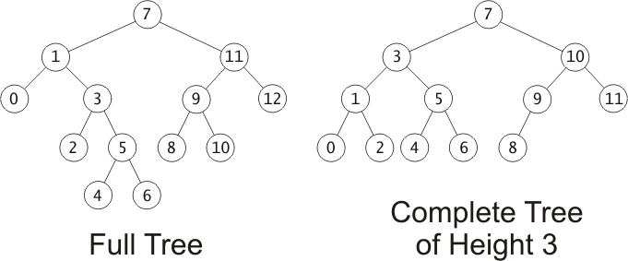
Completeness and Fullness
h - 2
h - 1
Full Tree
Complete Tree
A complete tree of height h is filled up to depth h-2, and, at depth h-1, any unfilled nodes are on the right.
Every node has 0 or 2 non-null children

Slide 13
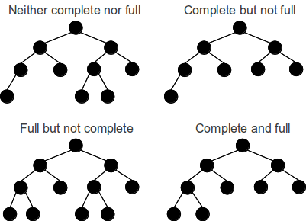
Completeness and Fullness
Resource: http://gsourcecode.files.wordpress.com/2012/02/complete-full-trees1.png

Slide 14
Expression Trees
Each node is an operator or an operand. The operands are leaf nodes. The operators are internal nodes.
*
*
What is the expression that this tree represents?
+
+
/
/
x
x
c
y
c
y
+
+
x
( )
+
y
( )
a
+
b
( )
/
*
( )
c
a
a
b
b

Slide 15

Task
Draw binary expression trees for the following expressions
1. x / y + a - b *c
2. (x * a ) – y / b * (c + d)

Slide 16
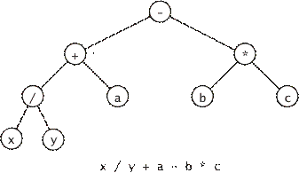
Solution (1)
x / y + a - b *c
(((x / y) + a) - (b *c))

Slide 17
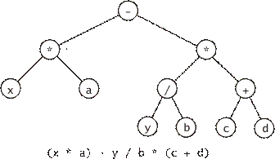
Solution (2)
(x * a ) – y / b * (c + d)
((x * a ) – ((y / b) * (c + d)))

Slide 18
Binary Search Trees (1)
The key of each node is greater than the keys in the left subtree nodes.
7
The key of each node is less than the keys in the right subtree nodes.
1
3
Let’s search for 4.
5
4

Slide 19
Binary Search Trees (2)
if the tree is empty, return NULL
if target equals to root node’s data, return that data
if target < root node data,
return search(left subtree)
otherwise return search(right subtree)
7
1
3
5
4
What is the advantage over vectors?
Both allow search O(log n). However, insertion and deletion is O(n) in vectors

Slide 20
Task
For each of the following trees, answer these questions. What is its height? Is it a full tree? Is it a complete tree? Is it a binary search tree? If not, make it a binary search tree.
binary search tree
height=3
40
40
height=3
40
30
55
binary search tree
30
55
40
32
55
32
35
50
32
55
30
32
Not Full
Not Complete
Not Full
Complete
30
35
50
Not a binary search tree
Not a binary search tree

Slide 21
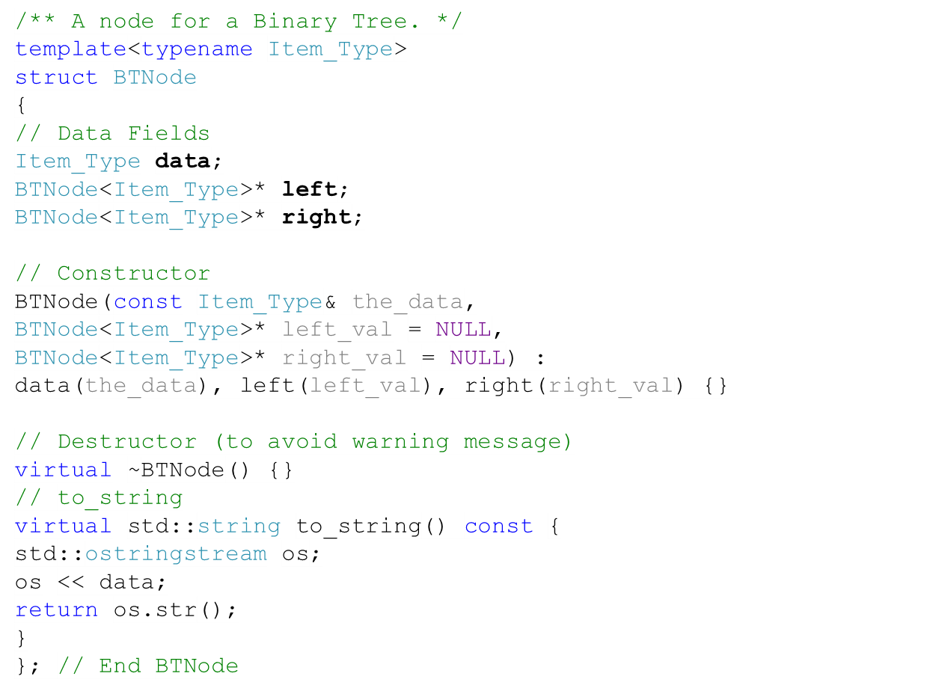
Implementing a Binary Tree Node
A Binary tree node
BTNode
left =
right =
data =

Slide 22
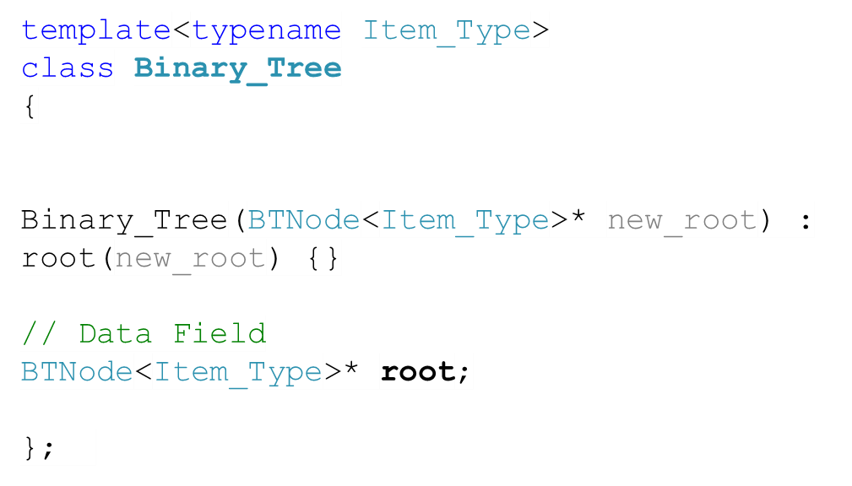
Implementing a Binary Tree
A Binary tree
Binary_Tree
BTNode
root =
left =
right =
data =
BTNode
BTNode
left =
left =
right =
right =
data =
data =

Slide 23

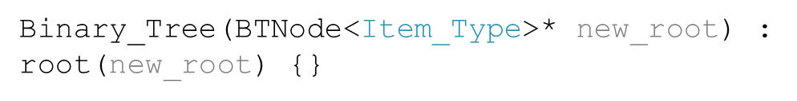
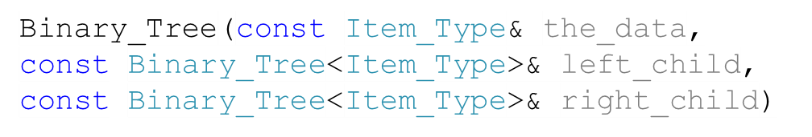
Binary Tree Constructors
Function | Behavior
 | Constructs an empty binary tree
 | Constructs a binary tree with the given node as the root.
 | Constructs a binary free with the given data at the root and the two given subtrees.

Slide 24




Binary Tree Functions
Function | Behavior
 | Returns the left subtree
 | Returns the right subtree
 | Returns the data in the root.
 | Returns true if this tree is a leaf, false otherwise.
 | Returns true if this is an empty tree, false otherwise
 | Returns a string representation of the tree

Slide 25
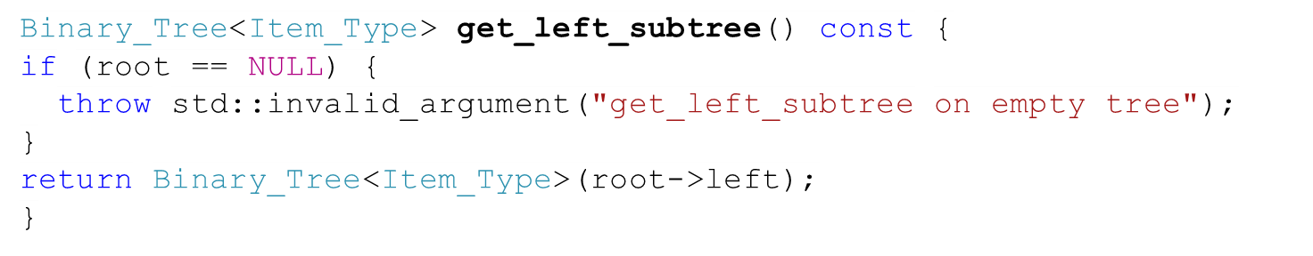
get_left_subtree()
root

Slide 26
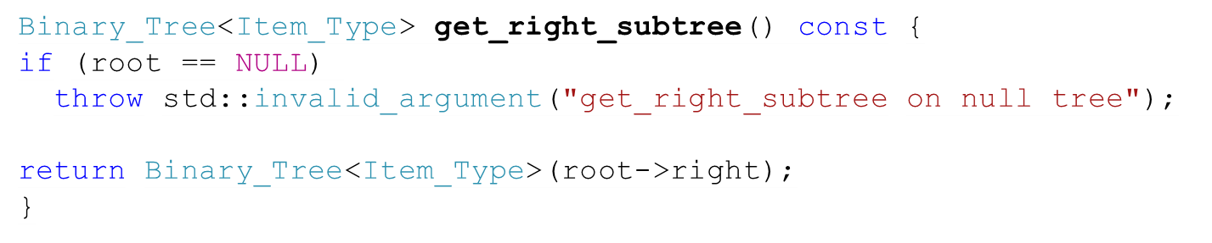
get_right_subtree()
root

Slide 27
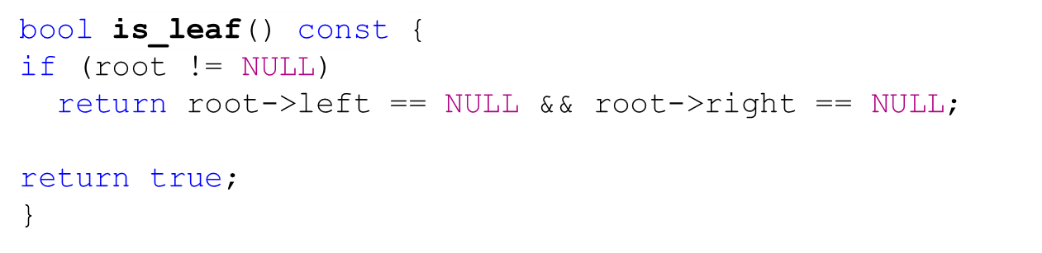
is_leaf()
root
false
true
root



Slide 28
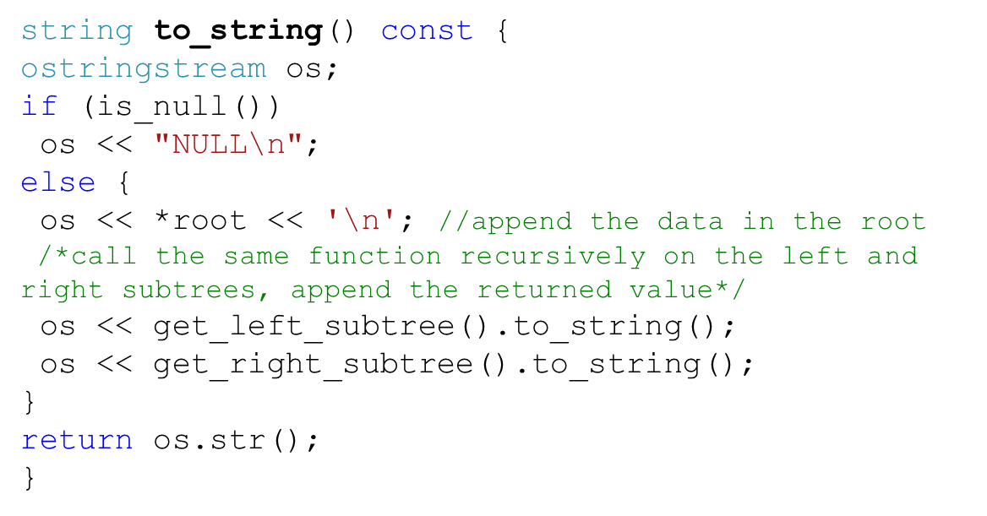
to_string()
root
A
B
E
C
D
F
A
B
C NULL NULL
D NULL NULL
E NULL
F NULL NULL

Slide 29
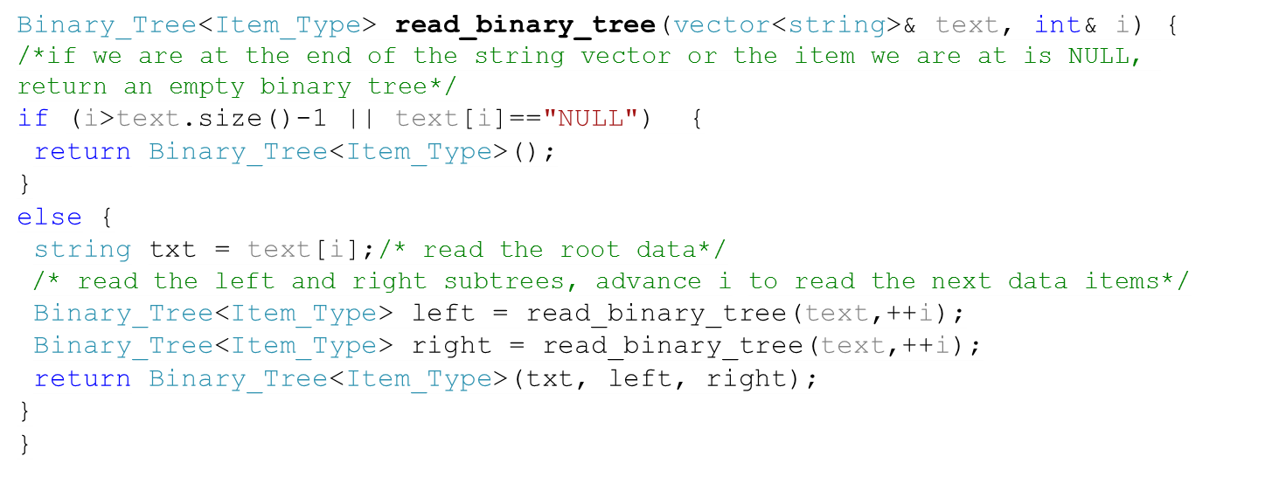
Populating Binary Trees
/
*
-
5
3
6
*
2
1
Called
populated
/ * 5 NULL NULL 3 NULL NULL – 6 NULL NULL * 2 NULL NULL 1

Slide 30
Task
Not in the book
Write a function that calculates the height of a binary tree.
4
1
/
2
1
1
3
*
-
1
1
1
1
2
1
1
1
5
3
6
*
1
1
1
1
2
1
Called
returned

Slide 31
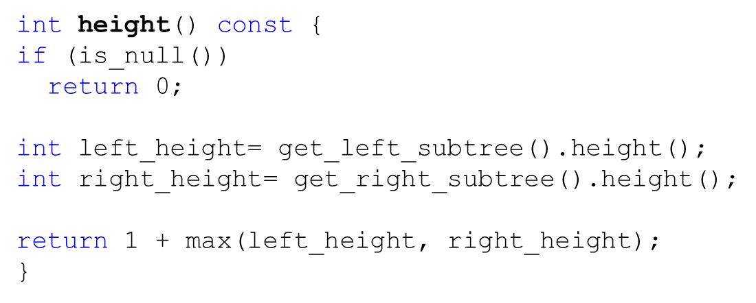
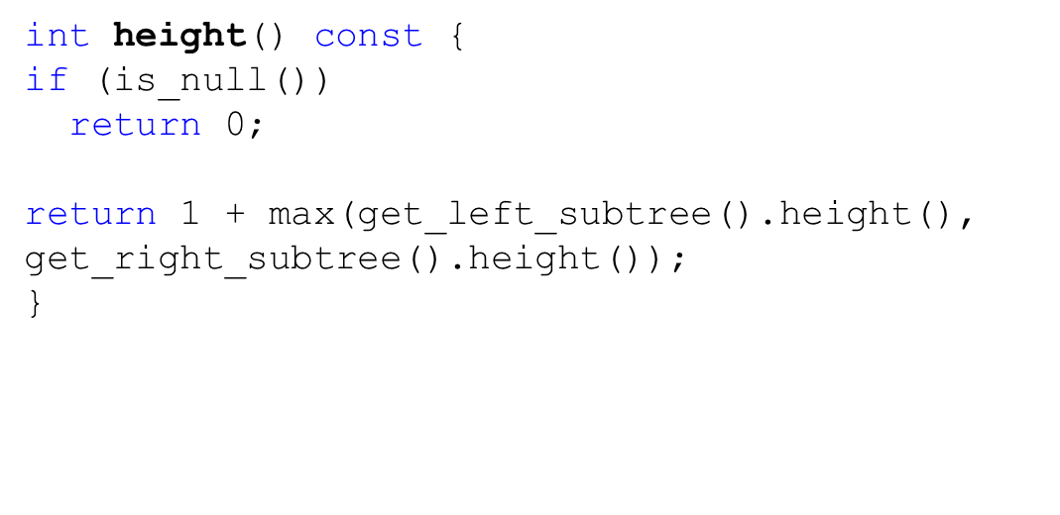
Task
Not in the book
Write a function that calculates the height of a binary tree.
4
/
2
3
*
-
1
1
1
2
5
3
6
*
1
1
2
1
Called
returned

Slide 32
Task
Not in the book
Write a function that calculates the depth of a node.
The depth is how far a node is from the root.
For instance, the depth of node “2” is 3
/
*
-
5
3
6
*
2
1

Slide 33
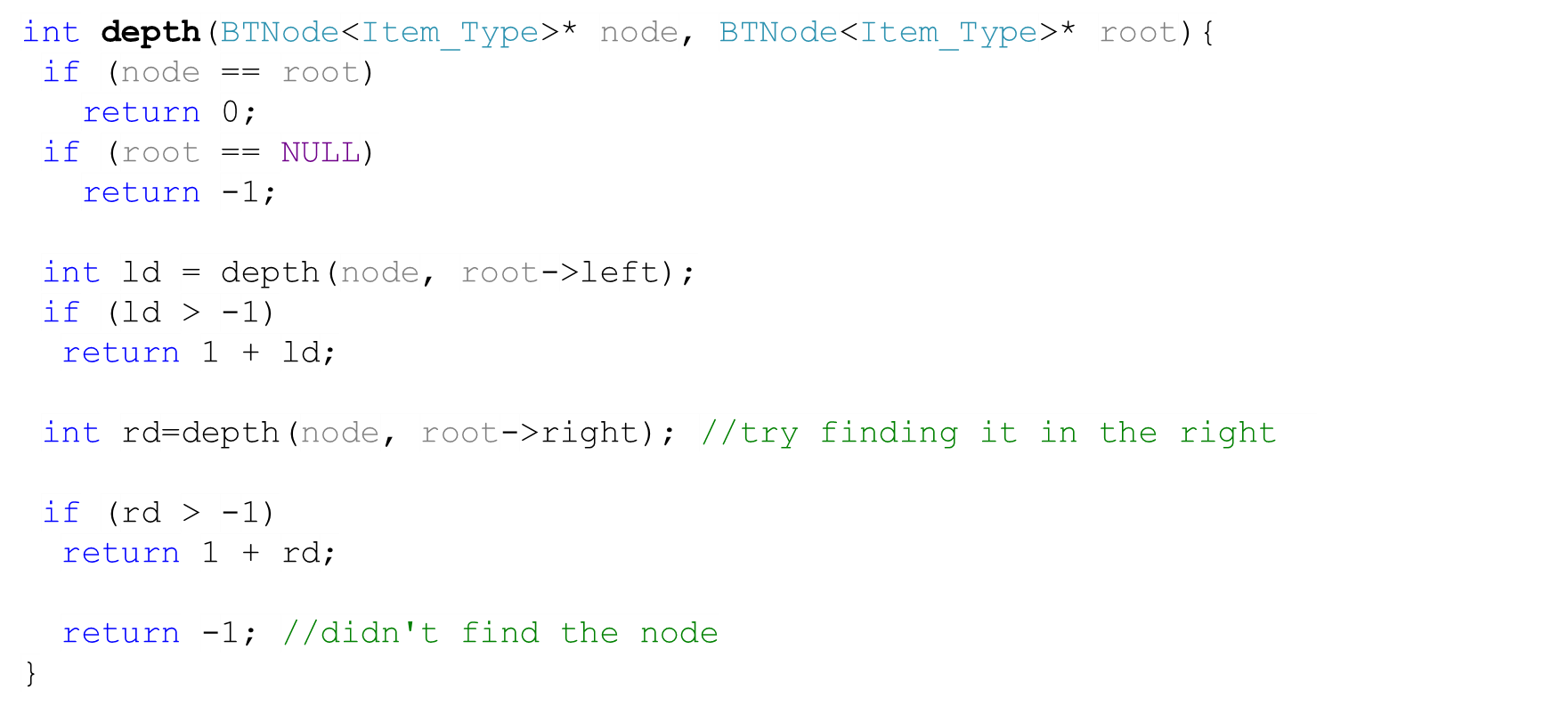
Solution
Not in the book
/
*
-
5
3
6
*
2
1

Slide 34
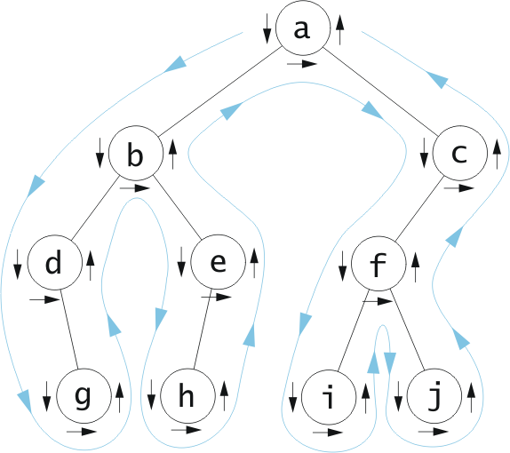
Tree Traversals
Often we want to determine the nodes of a tree and their relationship.
We can do that by walking through the tree and visiting the nodes.
Visiting the nodes: processing the information in the nodes.
This process is called tree traversal.
We’ll discuss three kinds of traversing trees (preorder, inorder, and postorder).

Slide 35
Preorder Traversal (algorithm)
if the tree is empty
Return
else
Visit the root
Preorder traverse the left subtree
Preorder traverse the right subtree
/
*
-
5
3
6
*
2
1
Prefix Expression
/
*
5
3
-
6
*
2
1

Slide 36
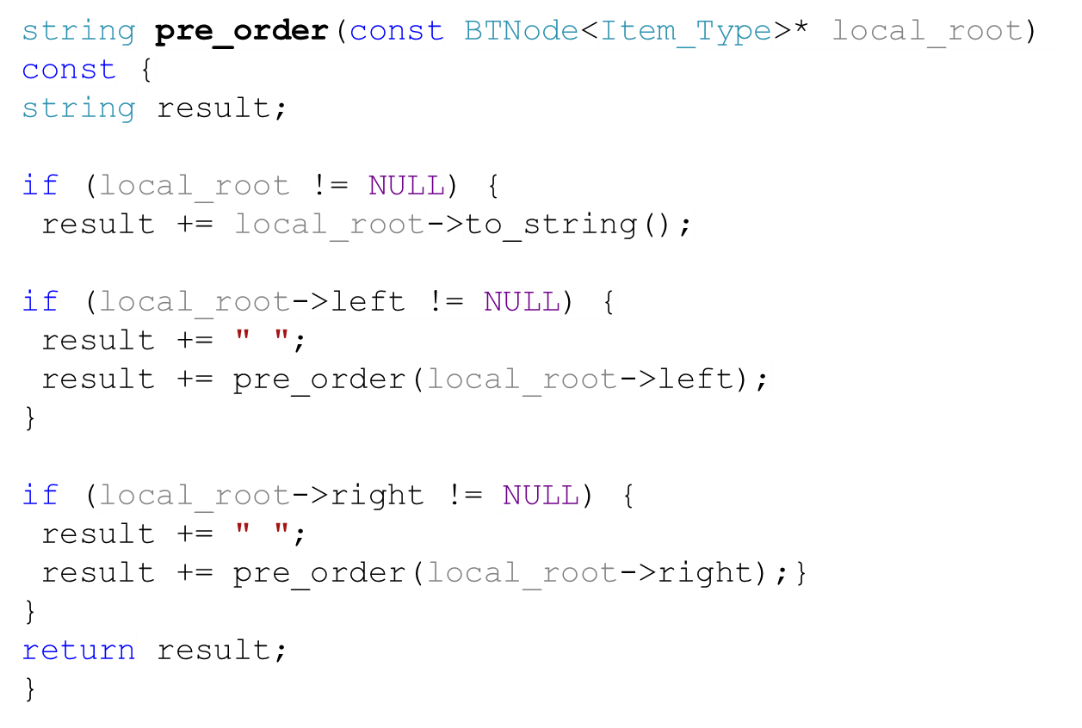
Preorder Traversal (source code)
/
*
-
5
3
6
*
2
1
Prefix Expression
/
*
5
3
-
6
*
2
1

Slide 37
Inorder Traversal (algorithm)
if the tree is empty
Return
else
traverse the left subtree
Visit the root
traverse the right subtree
/
*
-
5
3
6
*
2
1
Called
Visited
Infix Expression
( )
( )
5
*
/
( )
3
-
( )
6
2
*
1

Slide 38
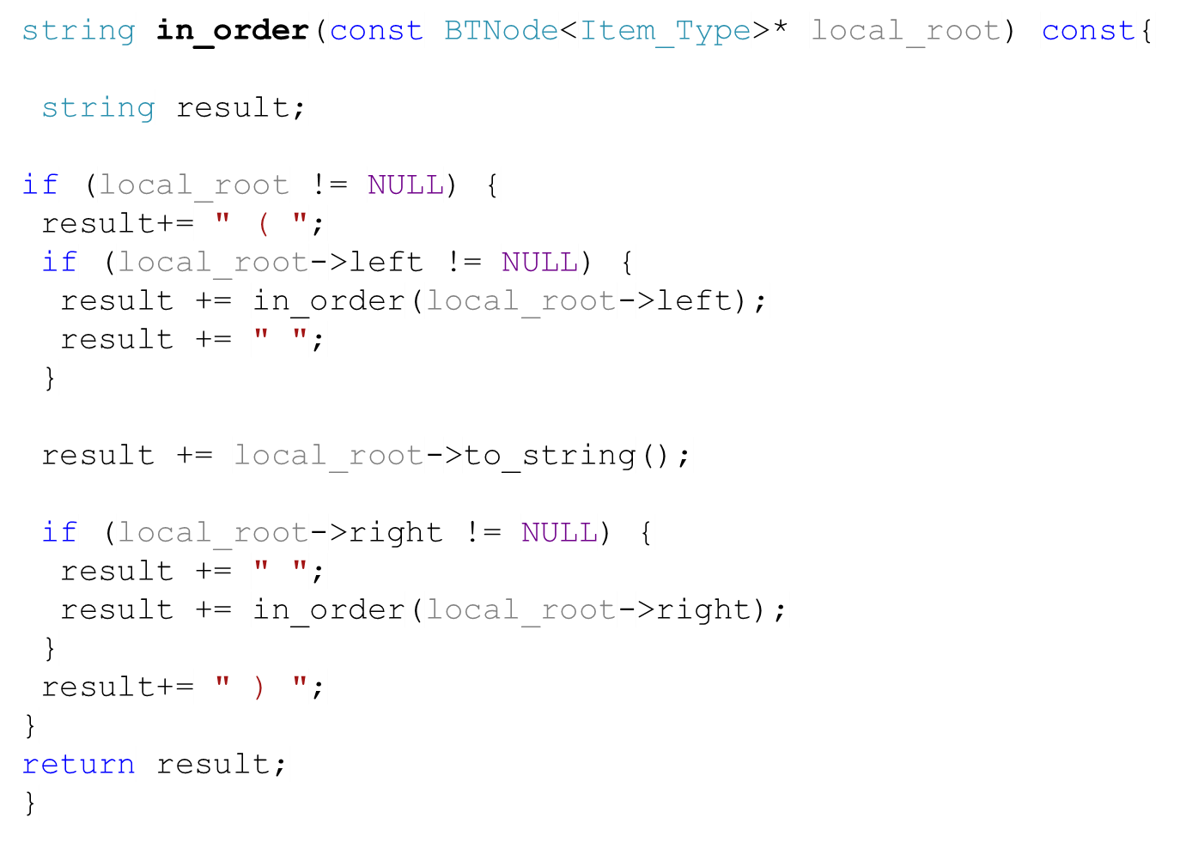
Inorder Traversal (source code)
/
*
-
5
3
6
*
2
1
Called
Visited
Infix Expression
(5)
(3)
*
/
( )
(6)
(1)
( )
( )
-
(2)
*
( )

Slide 39
Postorder Traversal (algorithm)
if the tree is empty
Return
else
Traverse the left subtree
Traverse the right subtree
Visit the root
/
*
-
5
3
6
*
2
1
Called
Visited
Postfix Expression
5
3
*
6
2
1
*
-
/

Slide 40
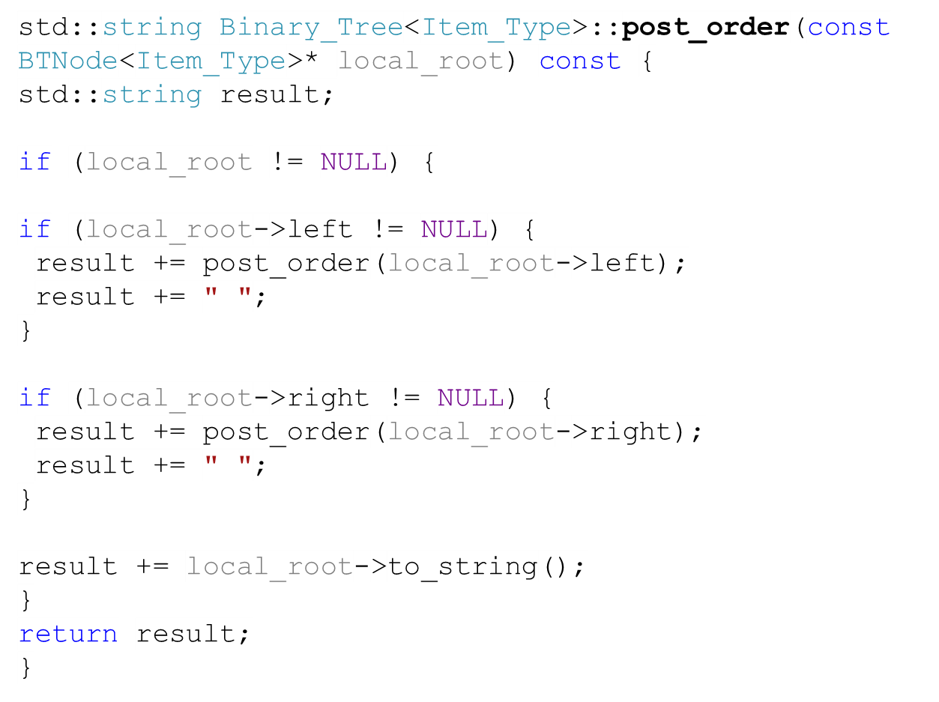
Postorder Traversal (source code)
/
*
-
5
3
6
*
2
1
Called
Visited
Postfix Expression
5
3
*
6
2
1
*
-
/

Slide 41
All Traversals Together
Preorder
Inorder
Postorder
if the tree is empty
Return
else
Visit the root
Traverse the left subtree
Traverse the right subtree
if the tree is empty
Return
else
Traverse the left subtree
Visit the root
Traverse the right subtree
if the tree is empty
Return
else
Traverse the left subtree
Traverse the right subtree
Visit the root

Slide 42
Quiz # 7
Task
Not in the book
Write a function that tests whether a binary tree is a full tree.
Note: You have access to the root.

Slide 43

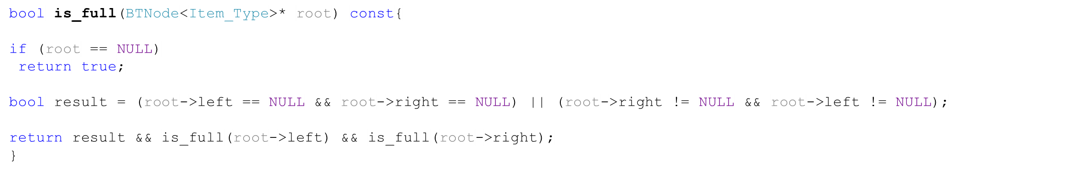
Quiz # 7 - Solution
Solution
Not in the book
result = false
called
returned

